Slide 1
Visualizing Building Performance Data
Arch 229 Final Presentation, Spring 2017
Elaina Present

Slide 2
Last Semester
Final House vs Base House: One Week Downstairs Common Area Temperature Comparison
We learned to model building energy performance using DesignBuilder.
We made sure to label our axes.
Tighter envelope gives less diurnal swing but higher temperatures without flushing.

Slide 3
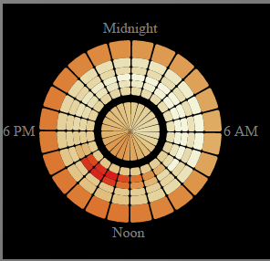
This Semester
We thought about ways to visualize our data.
Many audiences.
Many purposes.
Many options.

Slide 4
My focus: visualizing tradeoffs

Slide 5
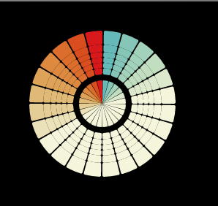
Figure Guide
Time and Space
Temperature
24 Hour Clock
85 °F
62 °F
Chilly
Warm
67 °F
Outer
Room
Temperatures
(Sized large to small, area proportional)
Inner
House Average Temperatures
77 °F
Comfort Range

